Slide 1
INTELLIGENT DECISON SUPPORT
(INTELLIGENT SYSTEMS)
(#4)
Prof. Dr. Ercan Oztemel

Slide 2
CONTENTS…
Progress of information systems
Definition and comparison of natural vs artificial intelligence
Intelligent behavior
Knowledge engineering
Knowledge acquisition and elicitation
Knowledge representation
Intelligent System Technologies
The way ahead…

Slide 3
Progress on Informatıon Technology
Intelligent Decision Making Systems
Business Intelligence and Decision Support Systems
Management Information systems
SOFTWARE Technology
Ofis automation systems
Data storing and transfering
Aritmatic operations

Slide 4
What is Intelligence? “Ability to learn, understand and think” (Oxford dictionary) “The capacity to learn and solve problems” (Webster's dictionary) in particular; the ability to solve novel problems the ability to act rationally the ability to act like humans

Slide 5
Business Intelligence? Collecting the relevant data and applying analytic techniques to infer new knowledge and report.

Slide 6
What Is Artificial Intelligence?
Artificial intelligence is the study of programmed systems that can simulate, to some extent, human activities such as perceiving, thinking, learning and acting.
Computers with the ability to mimic or duplicate the functions of the human brain

Slide 7
That Is To Say; AI is all about Making the computers to perform intelligent behavior by processing the knowledge. Knowledge is the main source of human intelligence. The more knowledge the better intelligence provided that the knowledge is the «right knowledge» for the specific purpose of use.

Slide 8
Intelligent Behavior
Learn from experience
Apply knowledge acquired from experience
Handle complex situations
Solve problems when important information is missing
Determine what is important
React quickly and correctly to a new situation
Understand visual images
Process and manipulate symbols
Be creative and imaginative
Use heuristics

Slide 9
Intelligent systems
Enriching the computers with intelligent behavior makes them to be able to:
learn or understand from experience;
make sense out of ambiguous or contradictory messages;
respond quickly and successfully to a new situation;
use reasoning in solving problems and directing conduct effectively;
understand and infer in ordinary, rational ways;
apply knowledge to manipulate the environment;
think and reason; and
recognize the relative importance of different elements in a situation.
…
…
These favors the BUSINESS and Decision Making for sure

Slide 10
What’s involved in Intelligence?
Ability to interact with the real world
to perceive, understand, and act
e.g., speech recognition and understanding and synthesis
e.g., image understanding
e.g., ability to take actions, have an effect
Reasoning and Planning
modeling the external world, given input
solving new problems, planning, and making decisions
ability to deal with unexpected problems, uncertainties
Learning and Adaptation
we are continuously learning and adapting
our internal models are always being “updated”
e.g., a baby learning to categorize and recognize animals

Slide 11
Acting Humanly: The Turing Test
Alan Turing (1912-1954)
“Computing Machinery and Intelligence” (1950)
Imitation Game
Human
Human Interrogator
AI System

Slide 12
Natural vs Artificial Intelligence
 | Natural Intelligence | Artificial Intelligence
Knowledge sustainability | May dissappear | May Continuou long
Knowledge transfer | Difficult | Very easy
Cost | Expensive | Cheap
Knowledge consistency | Inconsistent and variable | Consistent and stable
reusability | Not documentable | documentable
Decision making speed | More slower | More faster
Creativity | Creative | Not self creative
Knowledge sources | Sensing organs | Sensors
Focus | Broader | Narrow

Slide 13
Traditional vs AI Programs
 | Traditional Program | Artificial Intelligence
Source of information | Data | Knowledge
Knowledge handling | Algoritmic | Heuristic
Knowledge processing | Numeric | Symbolic
Working with insufficient information | No | Yes
Processing uncertain knowledge | No | Yes
Making errors | No | Yes
Adaptive bevaivour | No (static) | Yes (dynamic)
Level of intelligency | No | Up to the developers

Slide 14
The State of the Art
Computers are able to perform self-operation stock market
Unmanned factories are possible (machine to machine interaction- IoT)
Autonom decision making by the systems are spread out in Business
Business intelligence systems performs intelligent more sophisticated behavior
Computer beats human in a chess game.
Computer-human conversation using speech recognition.
Expert system controls a spacecraft.
Robot can walk on stairs and hold a cup of water.
Language translation for webpages.
Home appliances use fuzzy logic.
......

Slide 15
Software Development Life Cycle: Conventional vs Intelligent Systems
Traditional software development life cycle involves (generic)
→ Analysis
→ Requirements definition
→ Design
→ Implementation
→ Testing
→ Maintenance & review
Notes:
2

Slide 16
Software Development Life Cycle: Conventional vs Intelligent Systems
Intelligent systems on the other hand require;
special approaches to systems analysis, especially to the collection of the data (or rather knowledge) on which the system is based.
➔ KNOWLEDGE ENGINEERING
Notes:
2

Slide 17
The Term “Knowledge”
Knowledge is a collection of specialized facts, procedures and judgment rules etc.
Shallow knowledge
Surface level
Input-output
Deep knowledge
Problem solving
Difficult to collect, validate
Interactions between system components

Slide 18
Major Categories of Knowledge
Declarative Knowledge: relates to a specific object. Includes information about the meaning, roles, environment, resources, activities, associations and outcomes of the object
Procedural Knowledge: relates to the procedures employed in the problem-solving process
Meta Knowledge: refers to knowledge about the operation of knowledge-based systems and its reasoning capabilities

Slide 19
Knowledge Engineering
Art of bringing the principles and tools of AI to problems requiring knowledge for their solutions
Being acquainted with the technical issues of acquiring, representing and using knowledge appropriately to construct an intelligent system and explain the reasoning process.
Art of building intelligent computer programs that represent and reason with knowledge of the real world

Slide 20
Knowledge Engineering
The term "knowledge engineering" is often used to mean the process of
designing
building
installing
an intelligent system
In other words, the whole process of making an intelligent system from beginning to end.
Notes:
2

Slide 21
Required Knowledge Engineer Skills
Wide experience in knowledge engineering
Computer skills
Logical thinking
Intelligence
Fast-learning capabilities (of different domains)
Must understand organizations and individuals
Advanced, socially sophisticated verbal skills
Tolerance and ambivalence
Effective communication abilities
Broad educational background
Empathy and patience
Persistence
Versatility and inventiveness
Self-confidence

Slide 22
Knowledge Engineering Processes
Acquisition of knowledge
General knowledge or meta-knowledge
From experts, books, documents, sensors, files
Knowledge representation
Organized knowledge
Knowledge validation and verification
Inferences
Software designed to pass statistical sample data to generalizations
Explanation and justification capabilities
Notes:
2

Slide 23
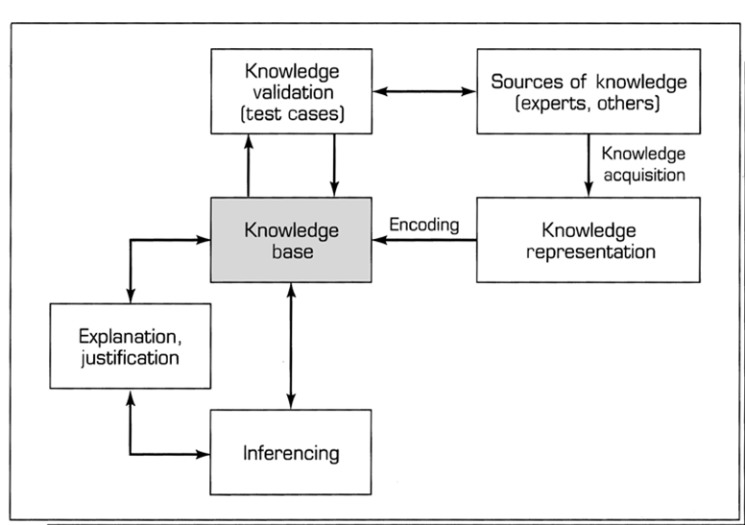
Knowledge Engineering Processes

Slide 24
Knowledge Acquisition
The process of gathering and eliciting the knowledge of a certain domain to populate the respective knowledge base.
Main bottleneck in developing intelligent systems.
Extremely difficult to manage.
Main source of failure in especially expert systems
Knowledge provider: Human experts
Notes:
2

Slide 25
Knowledge Acquisition
Sources of knowledge:
Documents: textbooks, journal articles, technical reports, records containing case histories, etc.
Databases
Internet
This will almost never be sufficient. Expert knowledge includes:
domain-related facts & principles;
problem-solving strategies;
meta-knowledge - for instance, knowledge about when to use a particular piece of knowledge;
explanations and justifications.
The range of problems which a textbook examines and solves is always smaller than the range of problems that a human expert is master of.
Notes:
2

Slide 26
Knowledge Elicitation
The most important part of knowledge acquisition is knowledge elicitation - obtaining knowledge from a human expert (or human experts) for use in an expert system.
To find out what, at least, an expert really know, and how he/she use the respective knowledge. Through
repeated interviews with the expert(s), probably combined with other, non-interview techniques
Notes:
2

Slide 27
Knowledge Elicitation - Difficulties
One major obstacle to knowledge elicitation: experts cannot easily articulate all they know about their subject.
They do not necessarily have much insight into the methods they use to solve problems.
Their knowledge is well- formulated but unreadable.
Experts may lack time or not cooperate
Testing and refining knowledge is complicated
Poorly defined methods for knowledge elicitation
The knowledge collected may be incomplete
Notes:
2

Slide 28
Knowledge Elicitation - Difficulties
System builders may collect knowledge from one source, but the relevant knowledge may be scattered across several sources
May collect documented knowledge rather than use experts
Difficult to recognize specific knowledge when mixed with irrelevant data
Experts may change their behavior when observed and/or interviewed
Problematic interpersonal communication between the knowledge engineer and the expert
Notes:
2

Slide 29
Knowledge Elicitation Techniques
Interviews
Questionnaires
Observations
Walk through
Protocol analysis
….

Slide 30
Knowledge Acquisition by Discovery
Knowledge discovery in databases (KDD) is the process of extracting useful patterns and models from raw data, and making those extracted patterns understandable and suitable for the resolution of decision problems.
KDD is a multistage process, in which data mining can be considered the core activity and it relates to the process and the set of techniques used to find (mine) underlying structure, information and relationships in normally large amounts of data.

Slide 31
Automated Knowledge Acquisition (Machine Learning)
Rule Induction (i.e ID3)
Explanation based learning
Case-based Reasoning
Neural Computing
Intelligent Agents

Slide 32
Knowledge Validation
It is necessary to verify the knowledge against the knowledge source (the expert or document).
It is also necessary to validate the knowledge against known outcomes.
The objective is to produce knowledge of high integrity.
Notes:
2

Slide 33
Evaluation
Assess an expert system's overall value
Analyze whether the system would be usable, efficient and cost-effective
Validation
Deals with the performance of the system (compared to the expert's)
Was the “right” system built (acceptable level of accuracy?)
Verification
Was the system built "right"?
Was the system correctly implemented to specifications?

Slide 34
The Internet/Intranet for Knowledge Acquisition
Electronic Interviewing
Experts can Validate and Maintain Knowledge Bases
Documented Knowledge can be accessed
The Problem: Identifying relevant knowledge (intelligent agents)
Many Web Search Engines have intelligent agents
Data Fusion Agent for multiple Web searches and organizing
Automated Collaborative Filtering (ACF) statistically matches peoples’ evaluations of a set of objects
WebGrid: Web-based Knowledge Elicitation Approaches
Information Structuring in Distributed Hypermedia Systems

Slide 35
Knowledge Representation
Knowledge Representation is defined as «putting the knowledge into a certain format so that the computer can understand it»
Similarly the following terms are used.
Knowledge building
Knowledge formulation

Slide 36
Knowledge Representation
Simple facts or complex relationships
Mathematical formulas or rules for natural language syntax
Associations between related concepts
Inheritance hierarchies between classes of objects
Knowledge is not a “one-size-fits-all” proposition.

Slide 37
Decision Tables
Decision table for the weather problem:
Main problem: selecting the right attributes
Also, not flexible enough
Outlook | Humidity | Play
Sunny | High | No
Sunny | Normal | Yes
Overcast | High | Yes
Overcast | Normal | Yes
Rainy | High | No
Rainy | Normal | No

Slide 38
Decision Tree
Outlook
sunny
overcast
rain
Humidity
Yes
No
high
normal
No
Yes

Slide 39
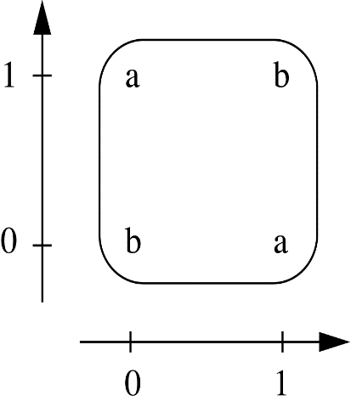
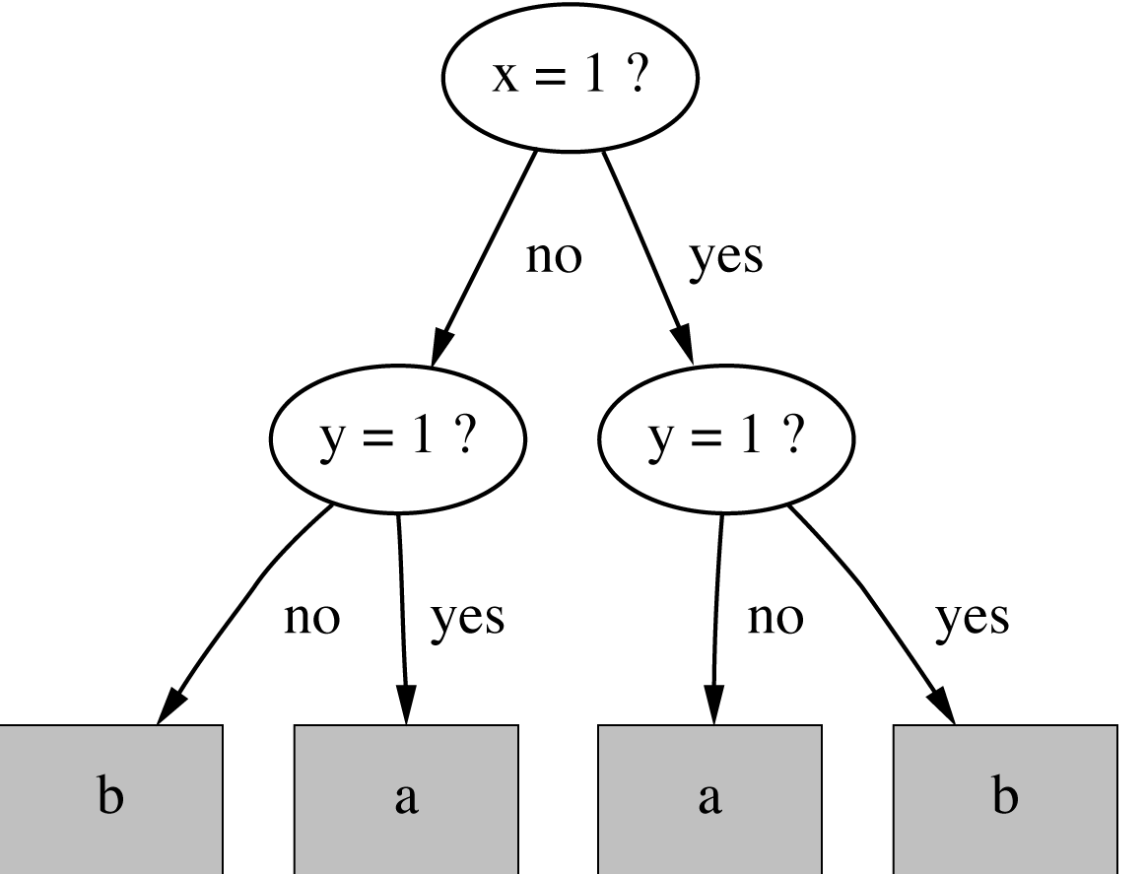
The Exclusive-Or (XOR) Problem
If x = 1 and y = 0 then class = a If x = 0 and y = 1 then class = a If x = 0 and y = 0 then class = b If x = 1 and y = 1 then class = b
witten&eibe

Slide 40
Production Rules
Traditionally the most popular form of knowledge representation
IF-THEN
Independent part, combined with other pieces, to produce better result
Model of human behavior
Format
(IF Precedence THEN Consequence)
Example
IF condition, THEN conclusion
IF conclusion THEN action
If condition, THEN conclusion1 (OR) ELSE conclusion2
(There could be multiple precedences and multiple consequences)

Slide 41
Production Rules
Examples of rules:
if condition P then conclusion C
if situation S then action A
if conditions C1 and C2 hold then condition C does not hold
If condition A then conclusion B with certainty F
(A, B, C, C1, C2, C3, P, S are all propositions)

Slide 42
Semantic nets
knowledge is represented as a collection of concepts, represented by nodes (shown as boxes in the diagram), connected together by relationships, represented by arcs (shown as arrows in the diagram).
certain arcs - particularly isa arcs - allow inheritance of properties.

Slide 43
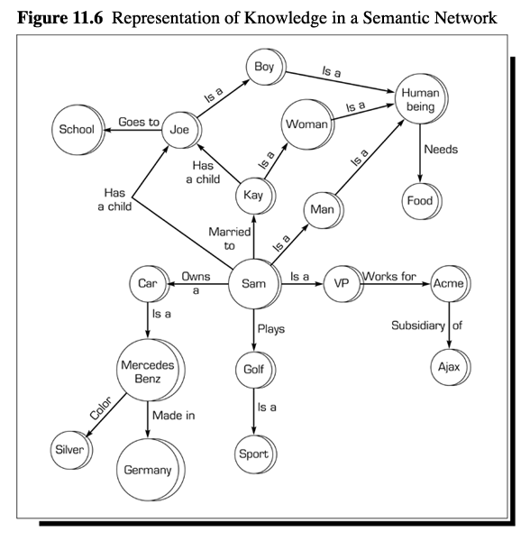
Semantic Networks
Graphical depictions
Nodes and links
Hierarchical relationships between concepts
Reflects inheritance

Slide 44
Frames
All knowledge about object
Hierarchical structure allows for inheritance
Allows for diagnosis of knowledge independence
Object-oriented programming
Knowledge organized by characteristics and attributes
Slots
Sub-slots/facets
Parents are general attributes
Instantiated to children
Often combined with production rules

Slide 45
Frames
A frame system is a hierarchy of frames
Each frame has:
a name.
slots: these are the properties of the entity that has the name, and they have values. A particular value may be:
a default value
an inherited value from a higher frame
a procedure, called a daemon, to find a value
a specific value, which might represent an exception.

Slide 46
Frames
An example of a frame:
“a car has 4 wheels, is moved by an engine, and runs on petrol or diesel.”
car subclass_ofthing
with
wheels: 4,
moved_by: engine,
fuel:
[value:
unknown,
type:
[petrol,diesel]].
Name: car Subclass of: thing
Slots:
Name: Value: Restrictions:
wheels 4
moved by engine
fuel ? petrol or diesel

Slide 47
Example of Frames
Frames
Vehicle
Wheels: Yes
isa
isa
Automobile
Doors: Yes
Motor: Yes
Wheels: 4
Cycle
Wheels: <4
isa
isa
Spots Car
Doors: 2
Size: Small
Bicycle
Motor: No
Wheels: 2
instance
Corvette
License:xyz2

Slide 48
Predicate Logic
Example:
“Minnesota is cold in the winter”
can be represented in three single parameter:
Place (Minnesota), Temperature(cold) and Season(winter).
Or it can be represented a single relation:
Cold (Minnesota, winter), Winter(Minnesota, cold).

Slide 49
Intelligent System Technologies
Expert Systems
Artificial Neural Networks (ANN)
Genetic Algorithms
Fuzzy Logic
Rule inductions systems
Case-based Reasoning and Analogical Reasoning
Intelligent agents

Slide 50
The Way Ahead…
Introduction to Expert Systems and fuzzy logic
Introduction to Artificial Neural Networks (ANN)
Data Mining
Intelligent Decision Support Systems
….

